Slide 1
CLOG DANCE

Slide 2
WELSH CLOG DANCE
Another part of the dancing competition in the Urdd is the clog dancing.
The dance was originally performed by farmers and slate quarry workers and often came in the form of a competition where dancers would show off their stamina and athleticism.
The difference between Welsh clogging and other step dance traditions is that the performance will not only include complicated stepping, but also 'tricks'.
For example, snuffing out a candle flame, 'toby stepping’, straddle jumps, handkerchief jumps, high leaps into the air, stepping and jumping over brooms.

Slide 3
CLOG DANCE

Slide 4
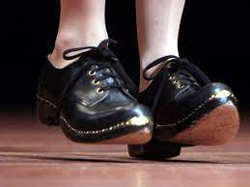
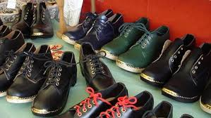
CLOGS
The shoes they wear in the dances are called ‘clogs’. They have a wooden sole and the uppers are typically made of leather. They have many styles and fastenings.

Slide 5
CLOG STEPS
Click on the link below to access the clog dancing video
http://resources.hwb.wales.gov.uk/VTC/2017/dawnsio-gwerin-english/index.html

Slide 6
CLOG RHYTHMS
Listen to the video again and match the word pattern with rhythm of the clogs. Can you hear the words matching with the pattern? Can you clap the rhythms?
I like dancing x3, Yes I do!
Quickly stepping, quickly stepping!
Cup of tea x2, drink another cup of tea!
Coca-cola, Pepsi!

Slide 7
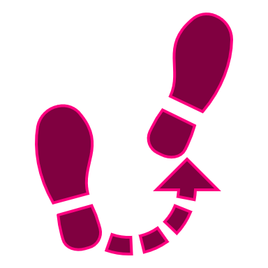
WORD PATTERNS
Let’s try some new word patterns.
I like fish and chips x3, it’s so good!
Chocolate cake x3, I want all of it!
Jumping over brooms x3, jump so high!
Snuffing out a candle x3, out it goes!
What do you notice about the way I have made my new word patterns?
I repeat the first line three times, then change the last
Can you make up your own word patterns in your group, using the same rules?

Slide 8
CLOG RHYTHMS
Here is our class rhythm:
I like dancing x3, here we go!
We will play this rhythm together between each of the group rhythms. Choose which order we will perform the groups.
Remember to only play when it is your group’s turn and we all play together on the class rhythm.

